Slide 1


Impact of Social Sciences, Humanities and Arts Conference
The Parallel Session on:
Using Interdisciplinarity for Societal Impact and Excellence
13 October, 2021

Slide 2
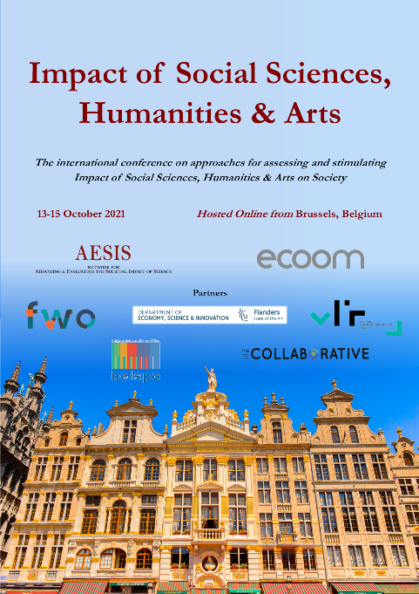

Impact of Social Sciences, Humanities and Arts
13-15 October, 2021
Sarah Weicksel (Chair): Director of Research and Publications at the American Historical Association, USA
Thomas Alslev Christensen: Senior Vice-President, Impact, Novo Nordisk Foundation, Denmark
Angelika Zelisko & Tobias Reckling: ‘Innovation Matters’ project, University of Applied Arts Vienna & University of Vienna, Austria
Overview of the Speakers
#SSHA21

Slide 3
Impact of Social Sciences, Humanities and Arts
13-15 October, 2021
Thomas Alslev Christensen
Senior Vice-President, Impact, Novo Nordisk Foundation, Denmark
#SSHA21

Slide 4
Novo Nordisk Foundation’s support to interdisciplinary science
Thomas Alslev Christensen
Senior Vice president, PhD
Impact

Slide 5
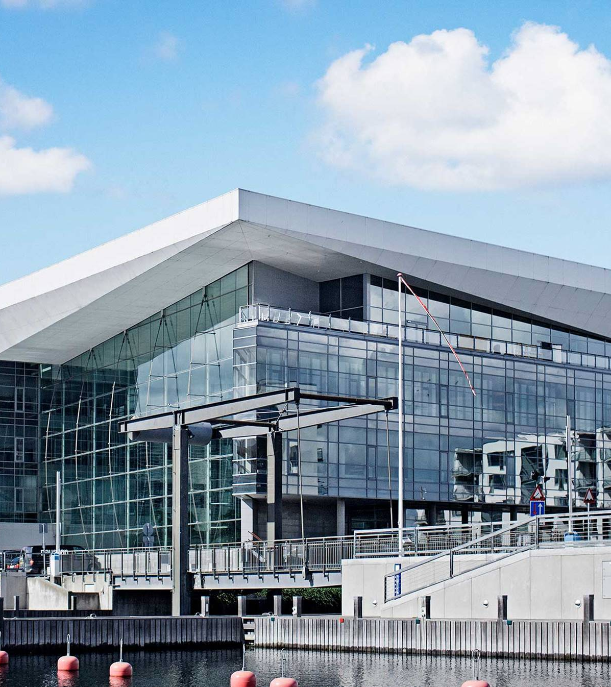

Facts about the
Novo Nordisk Foundation (2020)
The world’s largest
measured in assets:
USD ~100 billion
#1
The world’s third largest measured in grants
USD 915 million
#3
Two objectives:
Corporate objective
To provide a stable basis for the commercial and research activities of our companies.
Grant-giving objectives
To support scientific, research hospital, humanitarian and social purposes.

Slide 6









We fully support the life science cycle
- from basic education and research through innovation, start-ups and globally leading companies
Grant-giving activities
Commercial activities
Research centres and grants
Innovation Grants
Incubation/
Acceleration
Seed Investments
Venture Investments
Growth Investments
Principal Investments
Education

Slide 7










Interdisciplinarity is one of our focus areas
Interdisciplinarity
Biotechnology
Biomedical research
Life science research
Innovation
Health science research
Data science
Natural and technical science

Slide 8




Interdisciplinary Synergy Programmes
Natural and Technical Sciences
Biomedical and Health Sciences
To support research projects across disciplines, organizations and national borders, in order to resolve complex interdisciplinary challenges.
Social sciences and humanities
Life Sciences and Biotechnology
Key information
Pursue creative and novel, high-risk/high-gain interdisciplinary research ideas
Break down or overcome the barriers that exist between different disciplines
Consortia with 2 - 4 research groups
Main applicant anchored in Denmark. 1-3 interdisciplinary co-applicants (may be international)
Interdisciplinary Synergy Programme:
Ideally founded on early data showing feasibility of the idea
Grant budget: DKK 15 million over 4 years
Application deadline: June 2022
Exploratory Interdisciplinary Synergy Programme:
Aimed towards early-stage or unexplored ideas
Grant budget: DKK 5 million over 3 years
Application deadline: August 2021
RESEARCH AREA
Interdisciplinary
Notes:
PI and collaborators: Equal parts

Slide 9
Funding areas and grant types
Data Science Initiative
Industrial Biotechnology and Environmental Biotechnology
Plant Science, Agriculture and Food Biotechnology
Natural and Technical Sciences
Bioscience & Basic Biomedicine
Endocrinology & Metabolism
Clinical & Translational Medicine
Large Collaborative Grants
Collaborative
Tandem
Challenge Programmes
Interdisciplinary Synergy Programmes
Project Grants
Project Grants
Research Career Programmes
Investigator Grants
NERD
Investigator Grants
Postdoc Fellowships
Recruitment Programmes
Start Package Grants
RECRUIT
Young Investigator Awards and Laureate Research Grants
RECRUIT
Young Investigator Awards and Laureate Research Grants
Infrastructure Grants
Infrastructure Grants
Infrastructure Grants
Clinical Trials
Clinical Trials (IICT)
Innovation Grants
Innovation Grants
Innovation Grants
Notes:
These are research areas, not committees

Slide 10
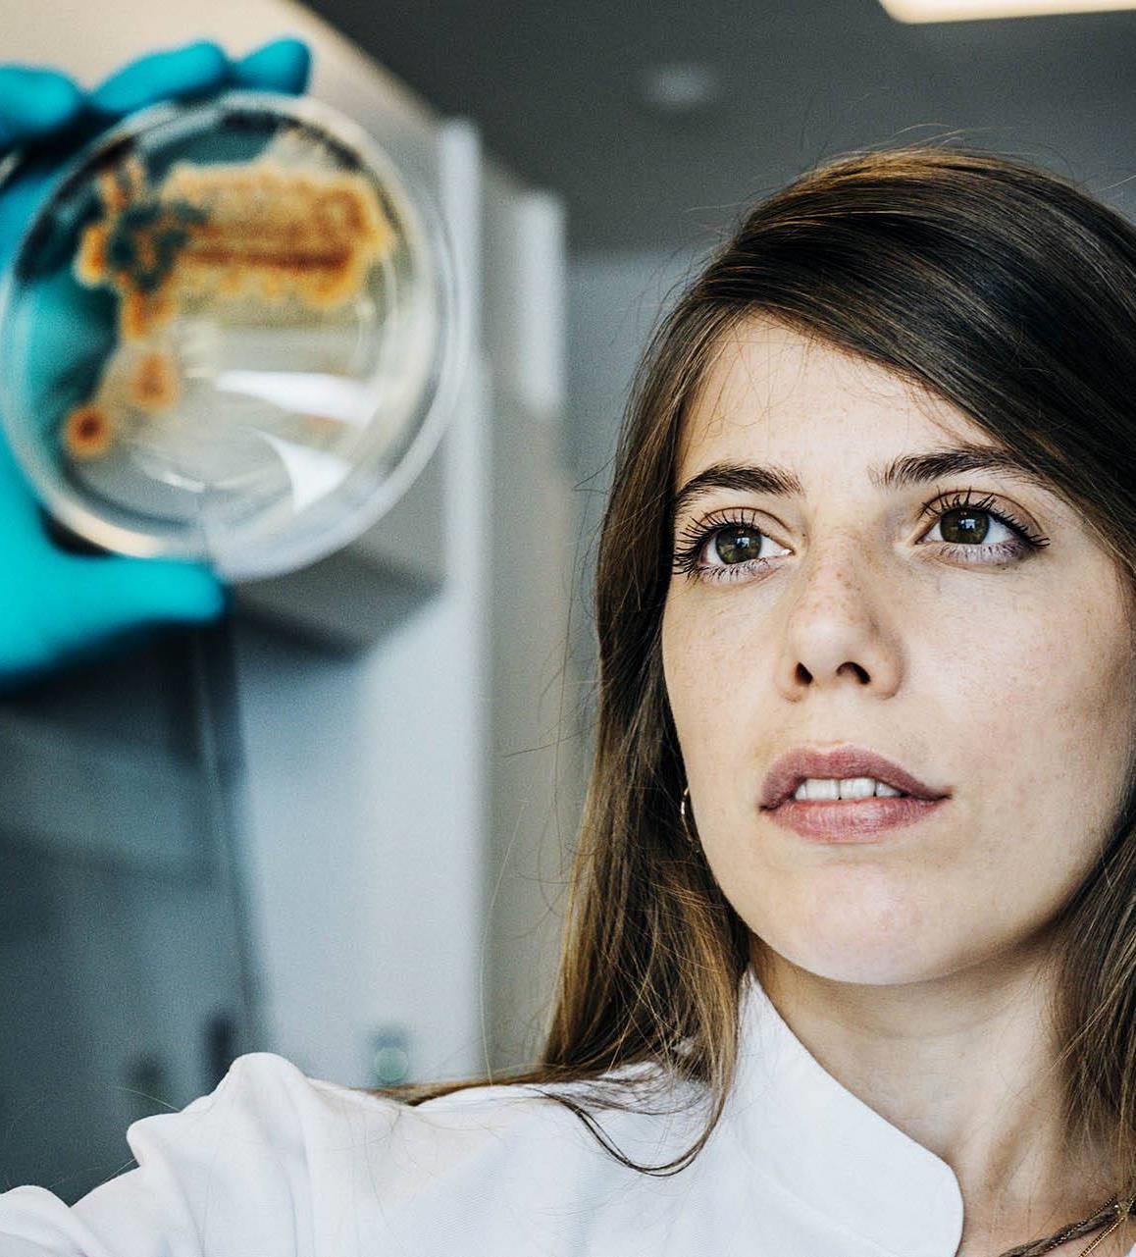
Challenge Programme
To overcome specific challenges in health, technology and environment
Key information
Substantial funding to challenging and ambitious projects focused on in-depth research
Annually selected research themes
A collaborative effort in a centre-like setup.
Consortia with 2 - 4 research groups
Main applicant anchored in Denmark. 1 - 3 co-applicants (may be international)
2022 themes announced at the end of this presentation
Grant budget: DKK 30 - 60 million over 6 years
Application deadline: 27 October 2021
RESEARCH AREA
Thematic
Notes:
2022 Themes announced at the end of this presentation

Slide 11

New Exploratory Research and Discovery (NERD) Programme
Supports highly creative, daring and ambitious researchers at any career stage after PhD
€2 million, 7-year, single-PI
Reverse single-blinded evaluation:
  Anonymous evaluation of project idea
  Feasibility check
Funding cap of €0.5 million per year as PI at start of project
Applicant must dedicate time to the project

Slide 12

Share of journal articles in top 1% and 10% of the world’s most frequently cited articles by number of field of sciences for authors and for all NNF-funded journal articles

Slide 13
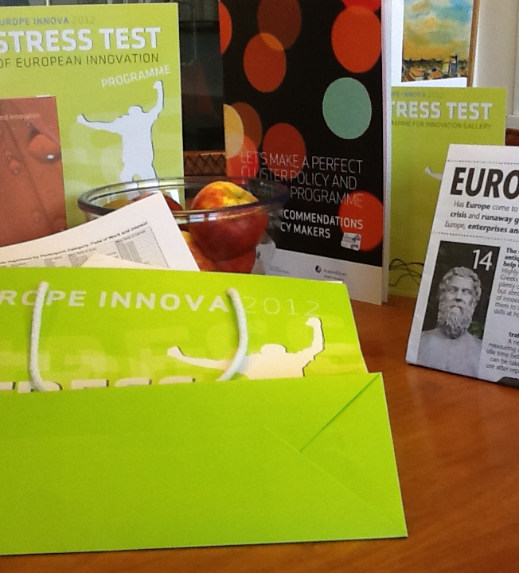
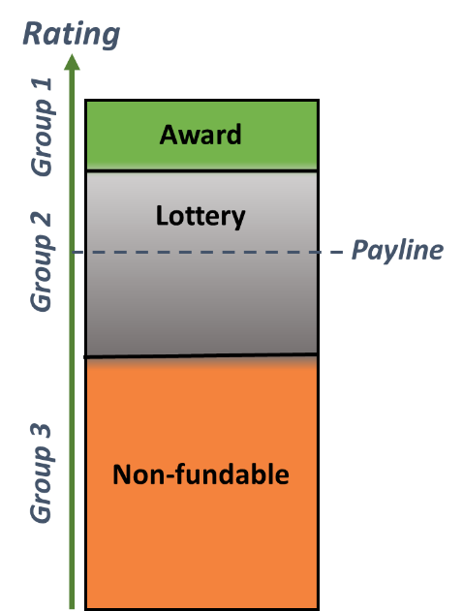
Implementation of partial randomisation to support more interdisciplinary (high risk/high gain) research

Slide 14
Impact of Social Sciences, Humanities and Arts
13-15 October, 2021
Angelika Zelisko & Tobias Reckling
‘Innovation Matters’ project, University of Applied Arts Vienna & University of Vienna, Austria
#SSHA21

Slide 15
INTERDISCIPLINARY KNOWLEDGE
EXCHANGE IN PRACTICE
The Project Knowledge Transfer Center East – Innovation Matters
Angelika Zelisko, University of Applied Arts Vienna
Tobias Reckling, University of Vienna

Slide 16

Who we are
Mag. Angelika Zelisko
DH Department Support
Art and Research
University of Applied Arts Vienna
Tobias Reckling, PhD
Team Manager Knowledge Transfer &
National Funding
University of Vienna

Slide 17





INTERDISCIPLINARY KNOWLEDGE
EXCHANGE IN PRACTICE: Knowledge Transfer Centers
  Knowledge Transfer Centers: funding scheme by
  the Austrian Promotion Bank (2014–2018,
  2019–2021)
  Funding for three regional consortia of universities and universities of applied sciences
  Aim: Support of all aspects of knowledge and technology transfer, including the social sciences, humanities, and the arts.
  Total funding 2019-2021: 900.000 € per consortium

Slide 18
INTERDISCIPLINARY KNOWLEDGE
EXCHANGE IN PRACTICE: Knowledge Transfer Centers
  Knowledge Transfer Center East
  Consortium of 9 universities and
  3 universities of applied sciences
  Approx. 20 external partners
  (i.e. funding agencies, City of Vienna, media)

Slide 19
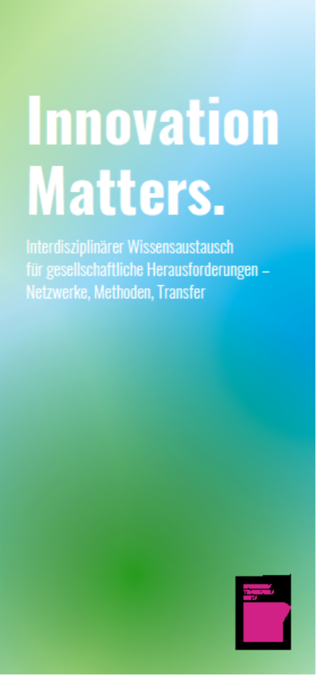
INNOVATION MATTERS:
Aims & Project Structure
Lead: University of Applied Arts Vienna & University of Vienna
Further partner institutions: Vienna University of Technology;
University of Natural Resources and Life Sciences, Vienna;
FH Campus Vienna; FH Technikum Vienna; University of Music and
Performing Arts, Vienna; University of Veterinary Medicine, Vienna
Aim: Fostering inter- and transdisciplinary cooperation
to address societal challenges by …
  Supporting the establishment of mission-driven interdisciplinary
  knowledge exchange Networks
  Teaching of Open Science & Innovation Methods
  Developing new Transfer Formats
Mission-driven approach
  Topics 2019–2021: i.e. Health – Education – Environment & Mobility

Slide 20
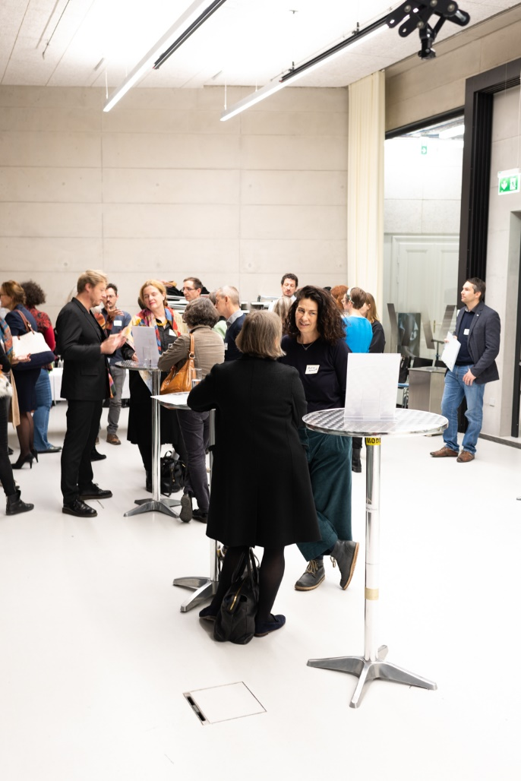
INNOVATION MATTERS:
Networks
What we aim for: Establishment of
inter- and transdisciplinary knowledge exchange networks
How we‘re trying to do it: Conceptualization and organization of small-scale inter- and
transdiscplinary networking events on specific topics; on invitation only.
Examples:
Research Salon #9 (2021): Environment
involving researchers from six universities from different disciplines plus local stakeholders and practicioners (City of Vienna, Climate Alliance Austria)

Slide 21

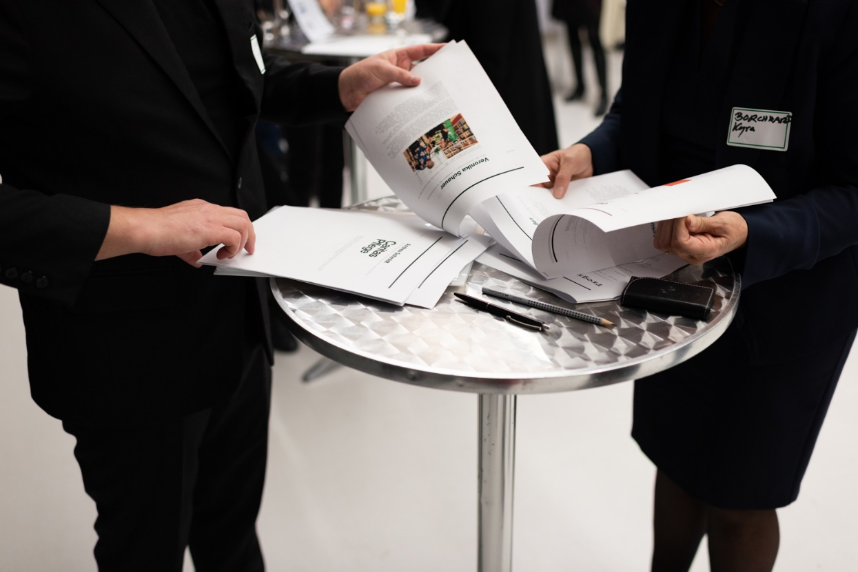
INNOVATION MATTERS:
Networks – Research Salon
Research Salon #5 “Health and Care”
Research Salon #8 “Education.
Perspectives, challenges, innovations”

Slide 22
INNOVATION MATTERS:
Networks – Research Salon
Research Salon #5 (2019, on site): “Health and Care”
involving researchers from six universities from different disciplines (arts, technology, life sciences, SSH ...) plus local stakeholder and practicioners (e.g.: Board of Trustees of Viennese Retirement Homes, City of Vienna, Caritas Care Unit)
Research Salon #8 (May 2021, virtual format):
“Education. Perspectives, challenges, innovations”
involving researchers from seven universities and universities of applied sciences from different disciplines (performing arts, applied arts, life sciences, technology) plus local stakeholder and practicioners (e.g.: ZOOM Children‘s Museum, Austrian Institute for School and Sports Facility Construction, Chamber of Labour)

Slide 23

INNOVATION MATTERS:
Methods
What we aim for: communication / teaching of open science and open innovation methods for scientists and practitioners
How we‘re trying to do it: following the Research Salon, organization of very topic-specific hands-on workshops
Example:
Upcoming: Open Science Methods & Environmental Research
Past: i.e. SenseBox – Citizen Science with Open Hardware and Open Data for SDG11

Slide 24

INNOVATION MATTERS:
Transfer
What we aim for: following the establishment of networks and the methods workshops… to make transfer happen.
How we’re trying to do it: development of transfer / knowledge exchange pilots
Examples:
Online Open Science Shop (University of Veterinary Medicine, Vienna)
Hackathon: Digital Solutions for Societal Challenges – Environment & Mobility

Slide 25
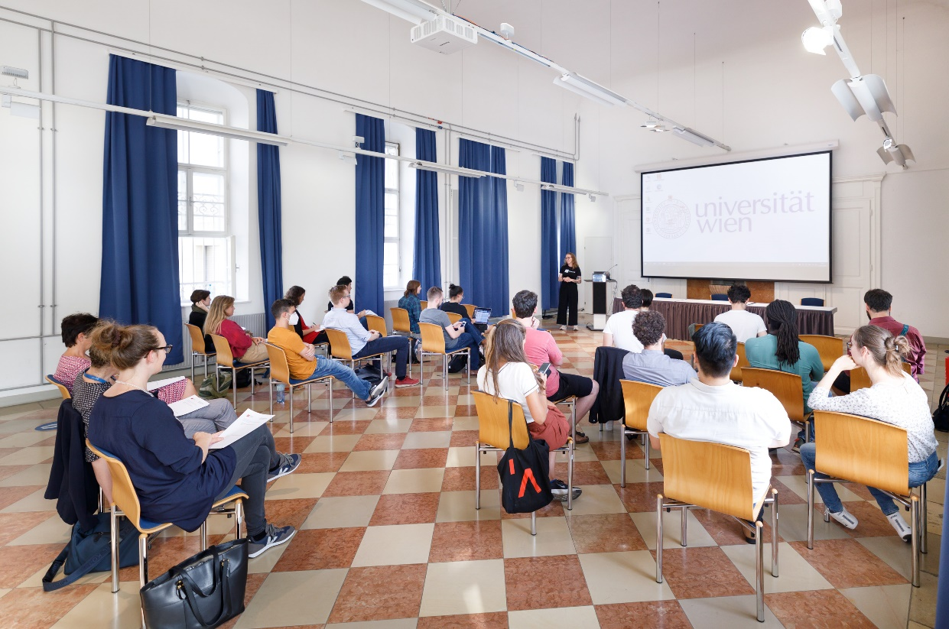
HACKATHON: Digital Solutions for Societal
Challenges – Environment & Mobility
Aim: development of digital participatory prototypes for societal challenges by interdisciplinary teams
Challenges: pre-defined challenges by the City of Vienna incl. (open) data sets
Mentors: Experts from the City of Vienna
Cooperation partners: i.e. City of Vienna, NGO SDG Watch Austria, Start-Ups, Digital City Vienna, Urban Innovation Vienna

Slide 26
Contact &
Further activities
Angelika Zelisko
angelika.zelisko@uni-ak.ac.at
Project Co-Lead
Innovation Matters
Tobias Reckling
tobias.reckling@univie.ac.at
Coordinator
Knowledge Transfer Center East
Co-Coordinator
Working Group UNICA & The City

Slide 27
Impact of Social Sciences, Humanities and Arts
13-15 October, 2021
Thank you!
#SSHA21

